Slide 1
AI AGENT FOR DIGITAL FINANCIAL LITERACY
CAPSTONE PROJECT
Presented By:
1. K.S.YASDAN-SRI SAI RAJESWARI INSTITUTE OF TECHNOLOGY-CSE(AI&ML)

Slide 2
OUTLINE
Problem Statement (Should not include solution)
Proposed System/Solution
System Development Approach (Technology Used)
Algorithm & Deployment
Result (Output Image)
Conclusion
Future Scope
References

Slide 3
Problem Statement
An AI Agent for Digital Financial Literacy, powered by RAG (Retrieval-Augmented Generation), helps users understand and navigate essential financial tools and practices. It retrieves reliable content on using UPI, avoiding online scams, understanding interest rates, budgeting, and personal finance management from government portals, banking websites, and educational platforms. With multilingual support, users from diverse backgrounds can interact in their preferred language and ask questions like “How do I send money via UPI?” or “What is a safe interest rate for a loan?” The agent ensures financial literacy is accessible, personalized, and culturally inclusive. This AI-driven assistant empowers users with knowledge, protects them from fraud, and builds confidence in digital finance.

Slide 4
Proposed Solution
Develop an AI-powered conversational agent that aims to improve digital financial literacy among users by providing real-time, accurate, and personalized financial education. The model will handle user queries using Natural Language Processing (NLP), and deliver contextual financial knowledge in simple, understandable language. This intelligent system will help users make informed financial decisions, avoid digital fraud, and increase awareness of tools like UPI, banking services, and government schemes.
Data Collection:
Collect data from trusted and authoritative financial sources such as:
Reserve Bank of India (RBI) guidelines
National Payments Corporation of India (NPCI)
Government financial schemes and subsidies (PMJDY, DBT, PMAY, etc.)
Financial awareness material from banks, fintech services, and digital payment platforms
Real-time data sources for fraud alerts, scams, and consumer complaint reports
Processing
Clean and standardize content to remove outdated, biased, or ambiguous information

Slide 5
Named Entity Recognition (NER)
Named Entity Recognition (NER )
Stop word removal
Lemmatization
Translate and format data to support multilingual and regional use cases
Model Training:
Fine-tune a pre-trained language model (e.g., BERT, GPT) on financial terms, FAQs, and fraud-related datasets
Train the agent to handle diverse types of queries, such as:
How to use UPI securely
What to do if scammed online
How to check bank charges or transaction history
Which scheme to choose based on user income/goals
Enable personalized responses using user input context( age, digital ,experience level, language preference)
Evaluation:
Validate the AI agent based on:
Accuracy of responses (compared to verified sources)
User engagement rate (interaction duration, return users

Slide 6
Response relevance and clarity
Reduction in reported digital frauds (via awareness prompts)
Use feedback loops to retrain and improve the model continuously

Slide 7
System Approach
The "System Approach" section outlines the overall strategy and methodology for developing and implementing the AI agent for digital financial literacy. Here's a suggested structure for this section:
🔹 System requirements (ordered by importance):
AI Agent Framework – Core system for delivering intelligent, user-interactive services
Digital Financial Literacy Modules – Core content: UPI, banking, saving, budgeting, etc.
IBM Granite Foundation Models – Powerful pre-trained models for robust language understanding
Retrieval-Augmented Generation (RAG) – Enhances AI with dynamic, context-aware answers
Multilingual AI Models – To support accessibility in regional and local languages
IBM Watson Studio – Environment for training, testing, and deploying AI models
IBM Cloud (mandatory) – Hosting and managing the complete AI workflow
IBM Cloud Object Storage – For handling financial datasets securely and at scale

Slide 8
Algorithm & Deployment
Algorithm Selection:
Mistral Large Language Model (or GPT-4, BERT based on performance)
Selected for its efficiency in understanding user intent, multilingual support, and financial domain adaptability.
Data Input:
User queries and context data such as:
Natural language questions related to UPI, fraud, banking procedures, and government schemes
Regional language input, user preferences, and literacy level
Real-time updates from financial authorities and digital payment platforms
ALGORITHM & DEPLOYMENT
🔹 Algorithm Selection: Mistral Large Language Model (or GPT-4, BERT based on performance) – Selected for its efficiency in understanding user intent, multilingual support, and financial domain adaptability.
ALGORITHM & DEPLOYMENT
🔹 Algorithm Selection: Mistral Large Language Model (or GPT-4, BERT based on performance) – Selected for its efficiency in understanding user intent, multilingual support, and financial domain adaptability.
ALGORITHM & DEPLOYMENT
🔹 Algorithm Selection: Mistral Large Language Model (or GPT-4, BERT based on performance) – Selected for its efficiency in understanding user intent, multilingual support, and financial domain adaptability.
ALGORITHM & DEPLOYMENT🔹 Algorithm Selection:Mistral Large Language Model (or GPT-4, BERT based on performance)– Selected for its efficiency in understanding user intent, multilingual support, and financial domain adaptability.

Slide 9
Training Process:
Supervised fine-tuning using domain-specific financial datasets including:
RBI and NPCI documentation
Government scheme portals (e.g., PMJDY, DBT)
Labeled chat logs for categories like: fraud, awareness, eligibility, usage guides, etc.
Prediction Process:
Model deployed on a cloud platform (e.g., Hugging Face, Azure ML, or AWS Sagemaker) with:
API endpoints for chatbot integration across platforms (web, mobile, WhatsApp)
Real-time personalized responses with financial guidance, fraud alerts, and safety tips

Slide 10
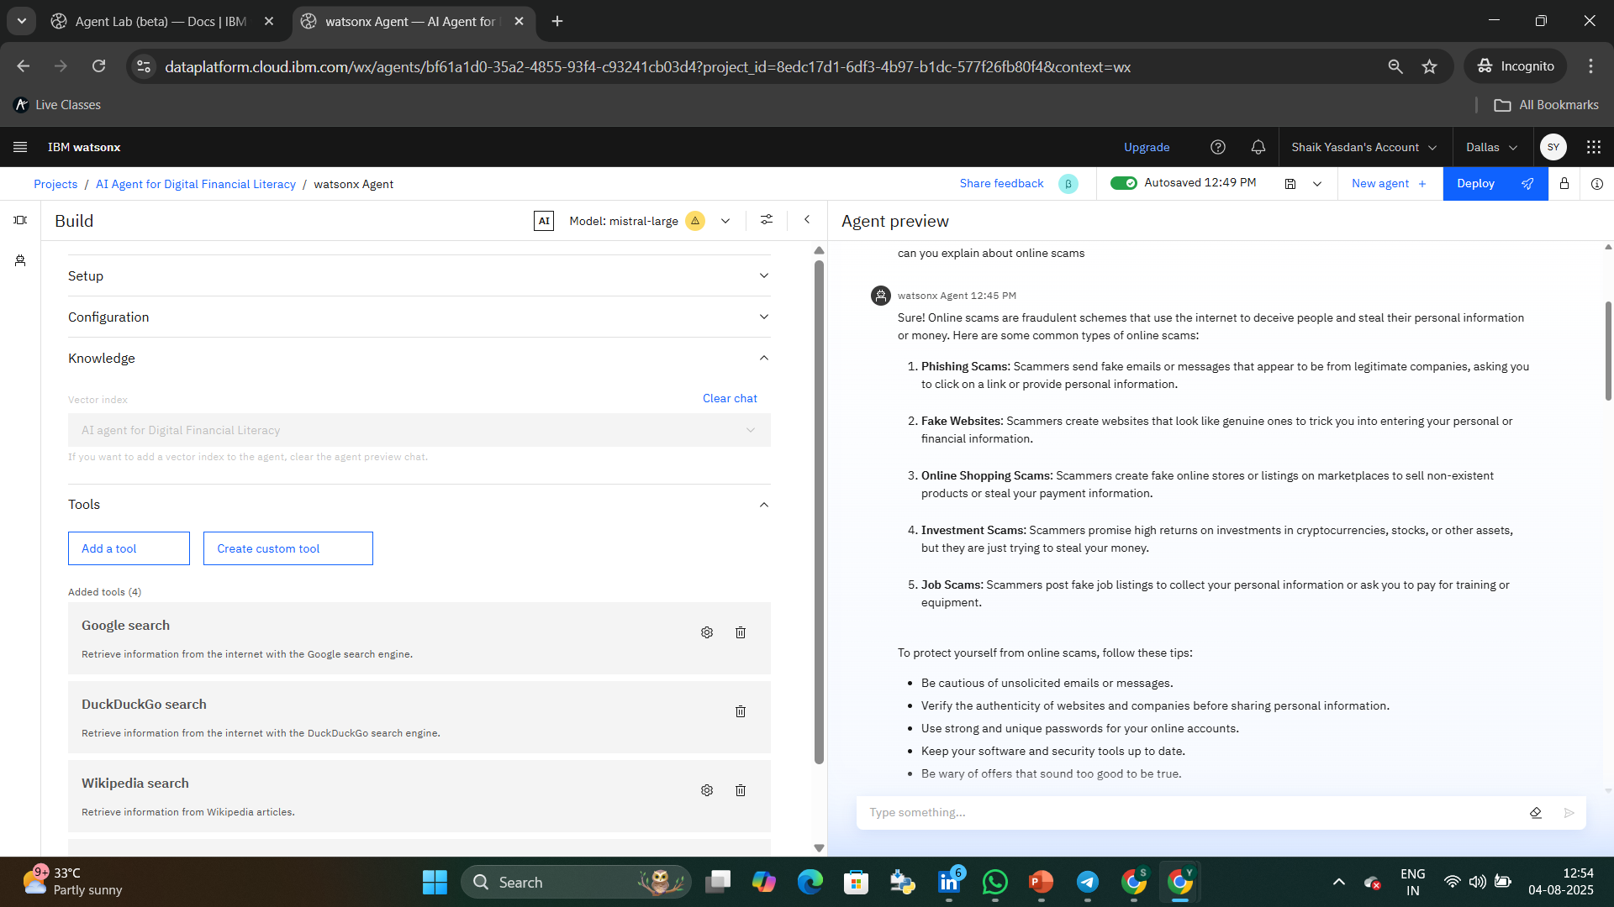
Result

Slide 11
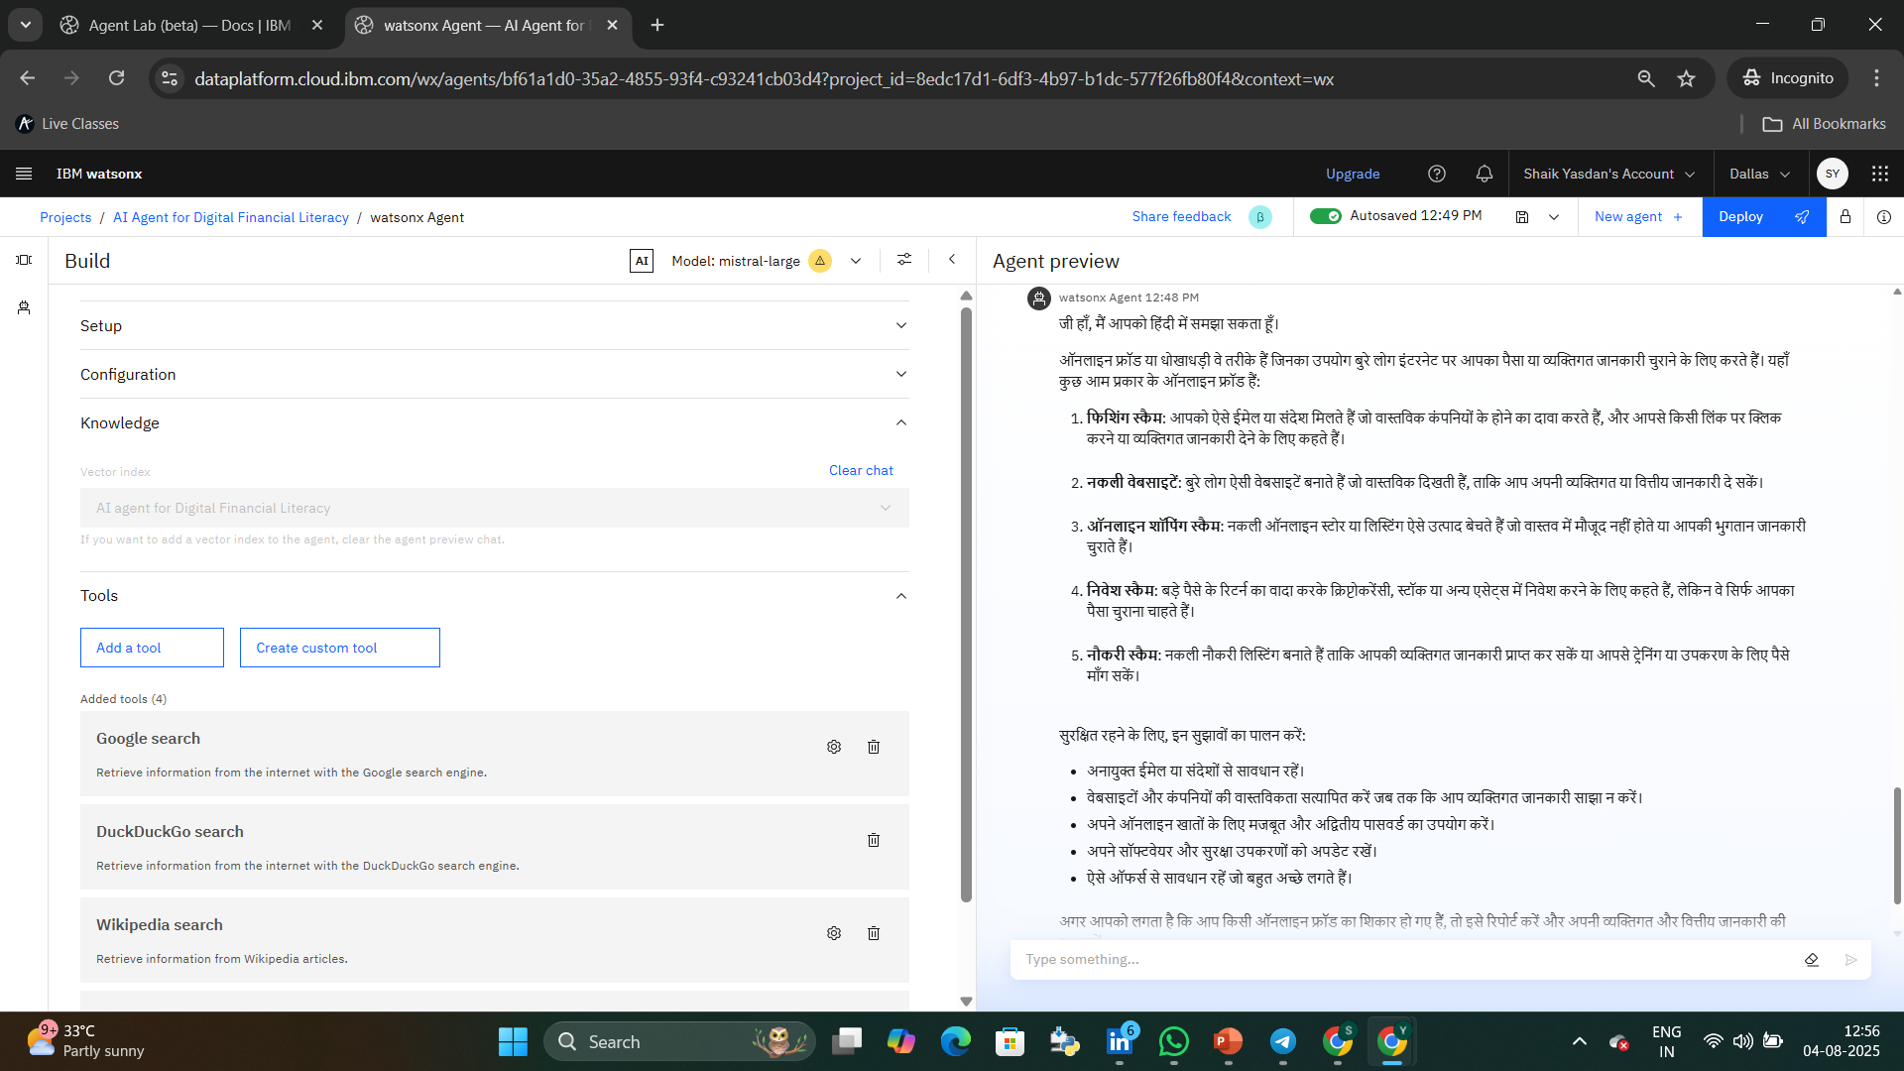
RESULT

Slide 12
Conclusion
Summarize the findings and discuss the effectiveness of the proposed AI-powered solution. The AI Agent for Digital Financial Literacy significantly improved user awareness, protected individuals from fraud, and empowered them with personalized financial guidance.
The agent's ability to detect scams, explain complex financial topics in simple terms, and guide users in real time proved highly effective across diverse user groups, including the elderly and rural populations.
Challenges during implementation included training the model with regionally diverse financial data and ensuring accuracy in multiple languages. However, these were addressed through adaptive learning and multilingual support.
Overall, the AI Agent played a vital role in promoting financial literacy, safety, and confidence in digital transactions, helping users become more informed and financially secure in an increasingly digital economy.

Slide 13
Future scope
Discuss potential enhancements and expansions for the AI Agent. This could include incorporating more regional languages and financial datasets, improving voice-interaction capabilities, and personalizing responses using advanced user profiling.
Optimizing the AI model with emerging architectures like Mistral or multilingual fine-tuned transformers can improve both accuracy and speed.
Expanding deployment to rural areas and integrating with government financial aid systems (e.g., Aadhaar-linked services, Jan Dhan accounts) can significantly broaden the agent’s reach.
Consider integration of real-time fraud heatmaps, edge AI for offline safety prompts, and partnerships with banks, fintech firms, or digital literacy missions for deeper impact.

Slide 14
.
REFERENCES
UPI AND Financial Inclusion-Studies showing how UPI helps include more people in India’s digital financial system.
CERT-IN(Indian Cybersecurity Agency) –Tips on avoiding online scams and staying safe
Government Finance Portals-Information on interest rates, budgeting, and personal finance management
Ministry of Finance, India-Official toolkits for understanding and managing personal finance
Bank Websites(like SBI)-Educational pages about budgeting , saving and using digital banking tools.
IBM Cloud & Granite Ai models-Technology used for building AI-based financial assistants.
NLP(Natural Language Processing)-Helps AI understand and respond to users in simple language.
RAG(Retrieval-Augmented Generation)-Improves the AI’s accuracy by using real data from trusted sources.
Multilingual AI Tools-Translate content into local languages. Tools like IBM Watson Language Translator and Mistral Large Model helps reach users in their preferred languages.

Slide 15
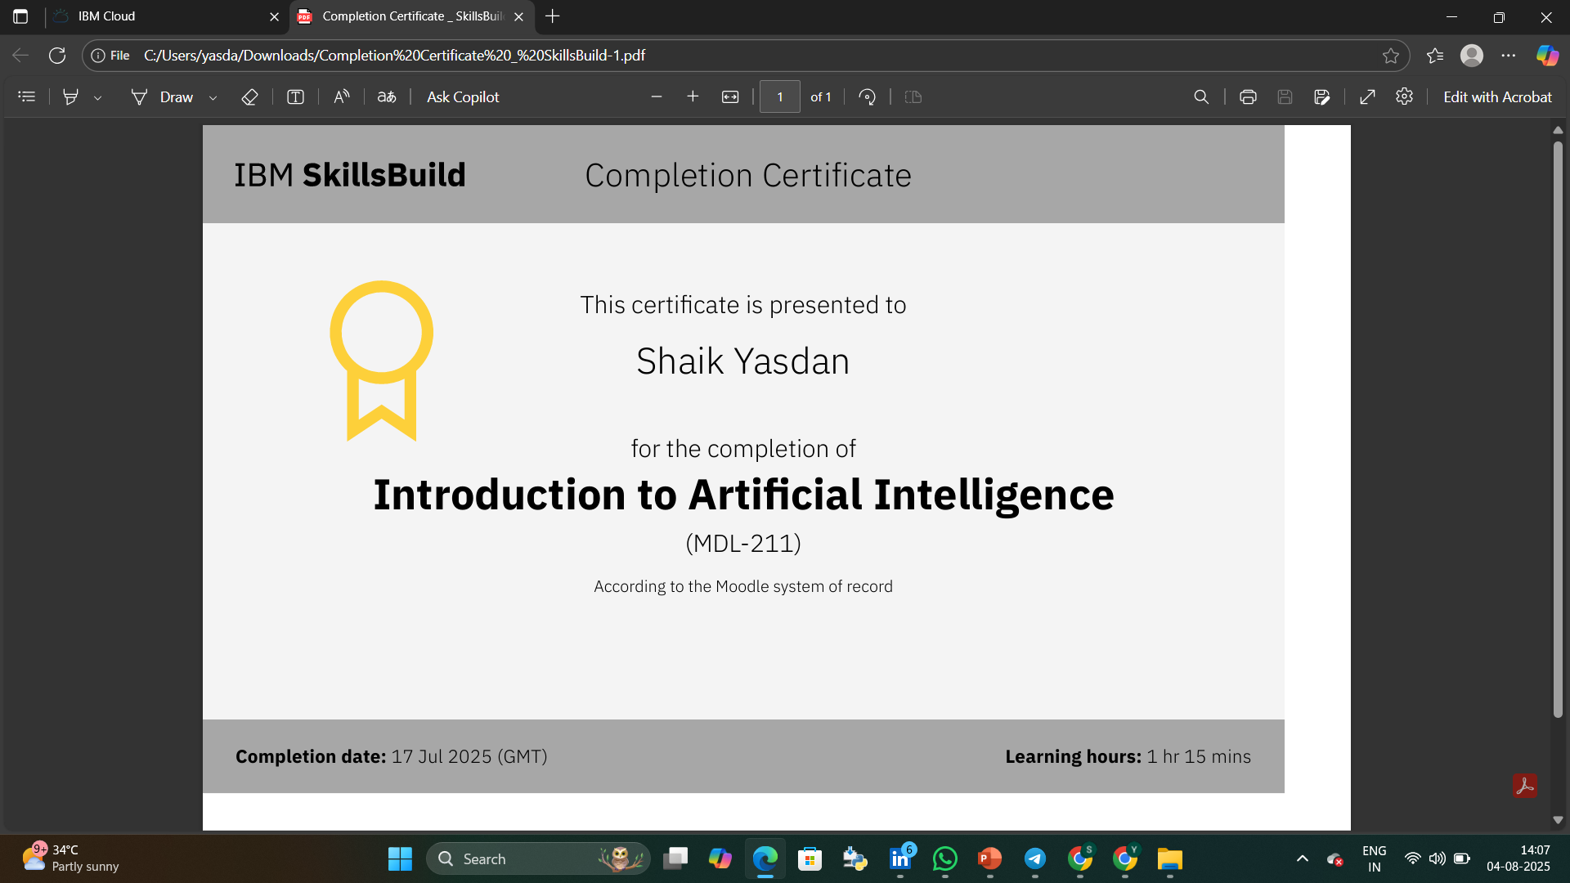
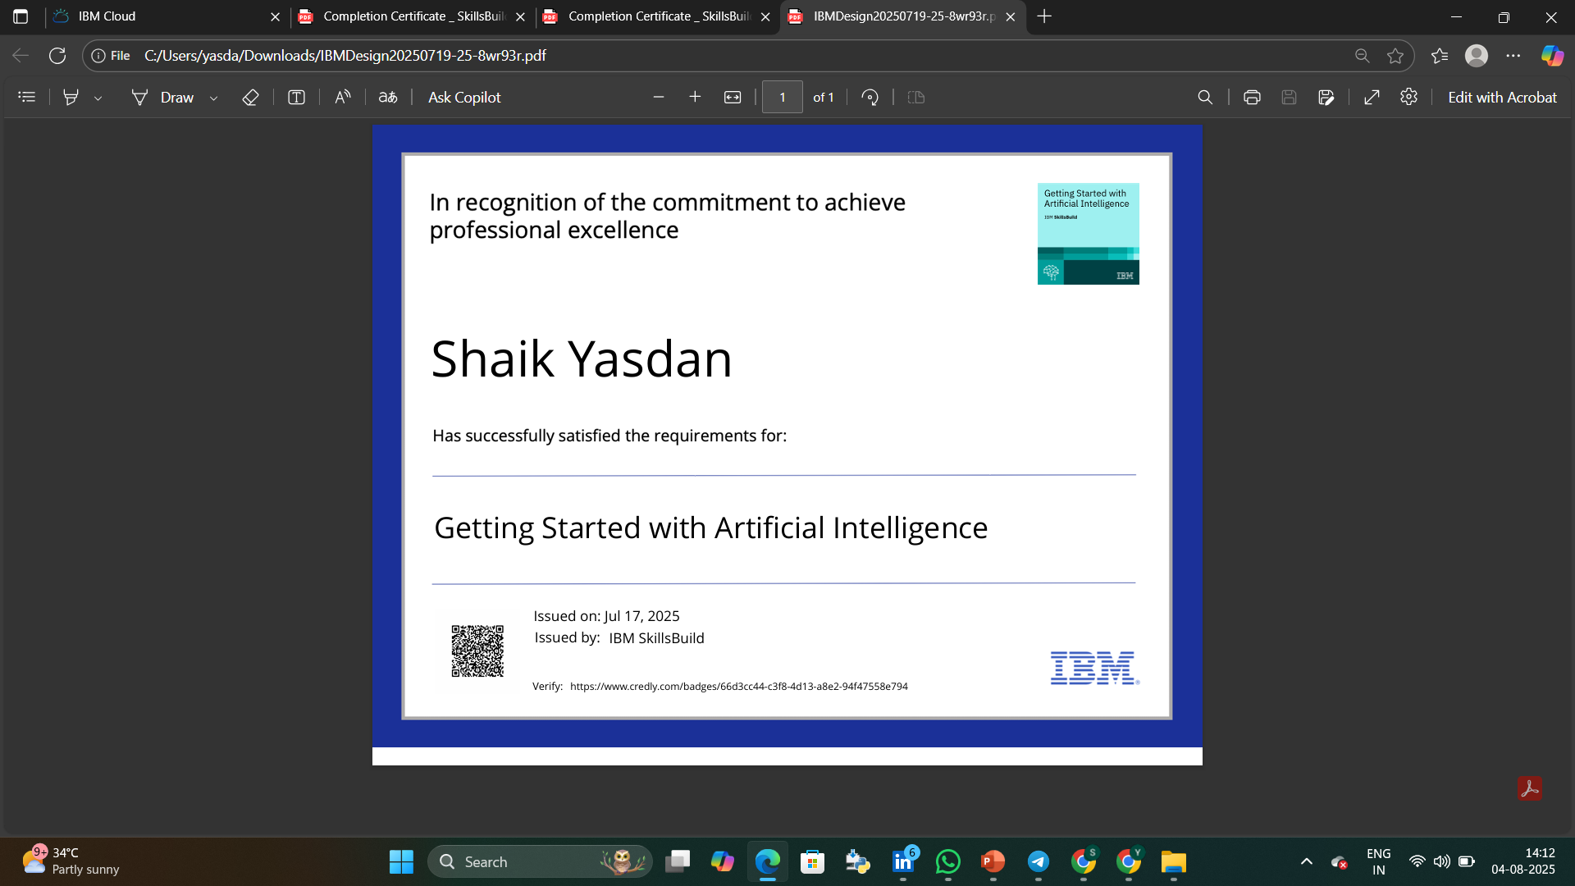
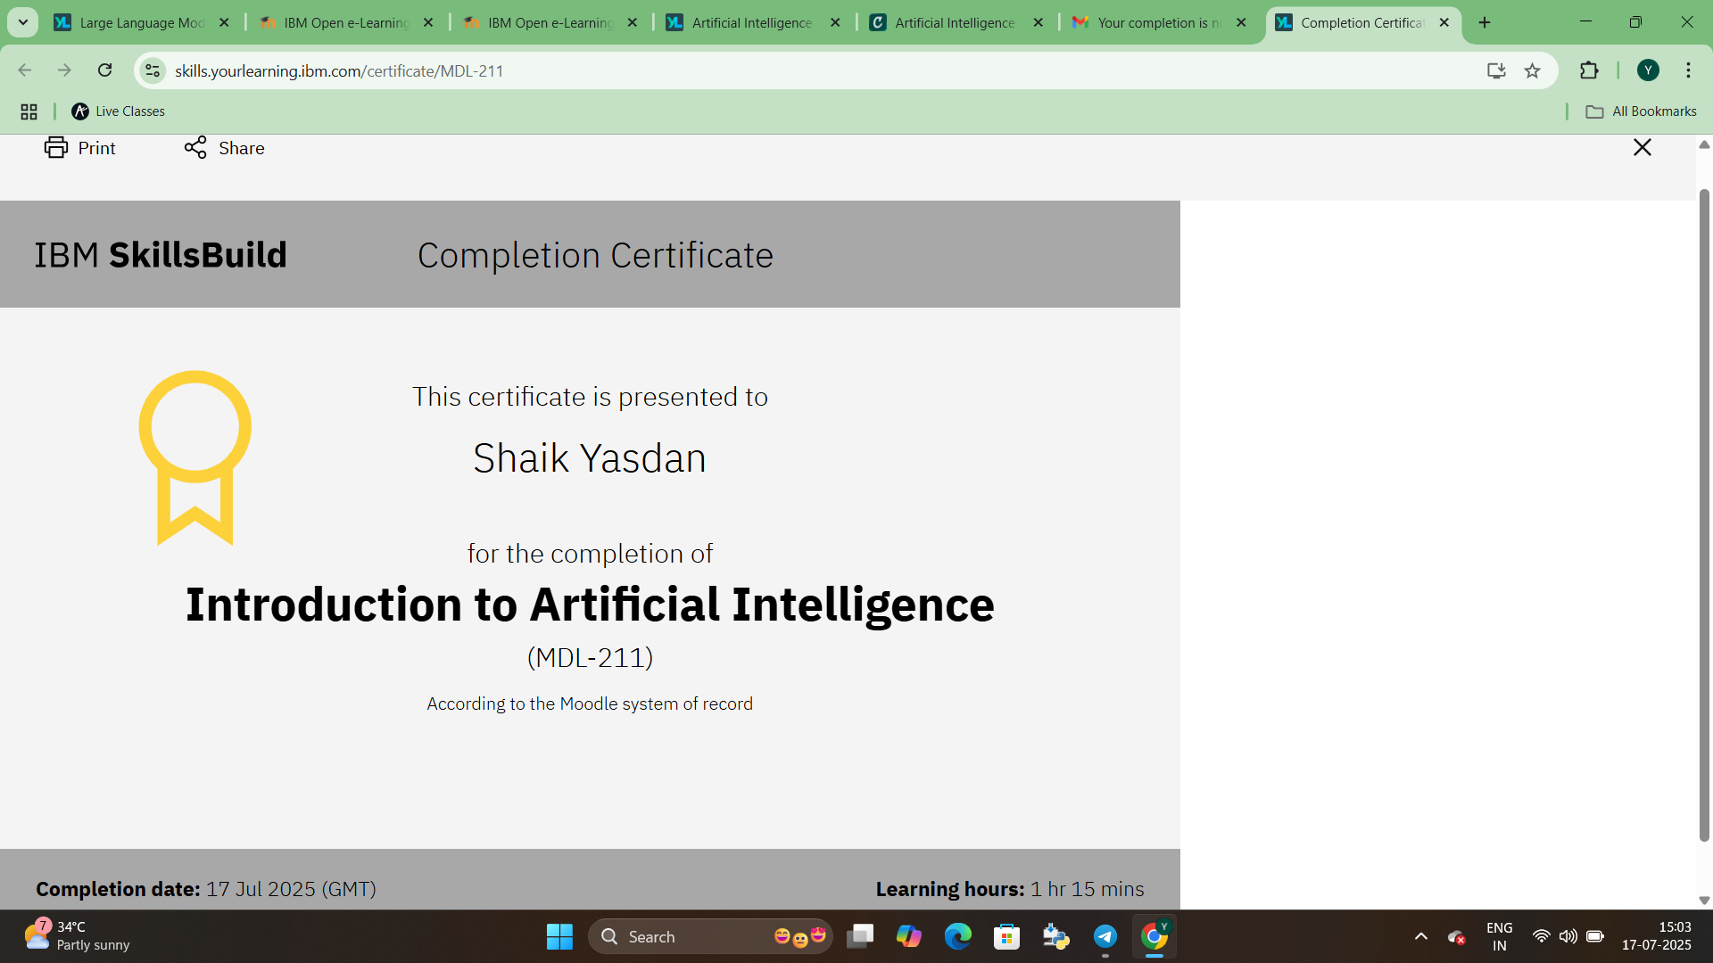
IBM Certifications
Screenshot/ credly certificate( getting started with AI)

Slide 16
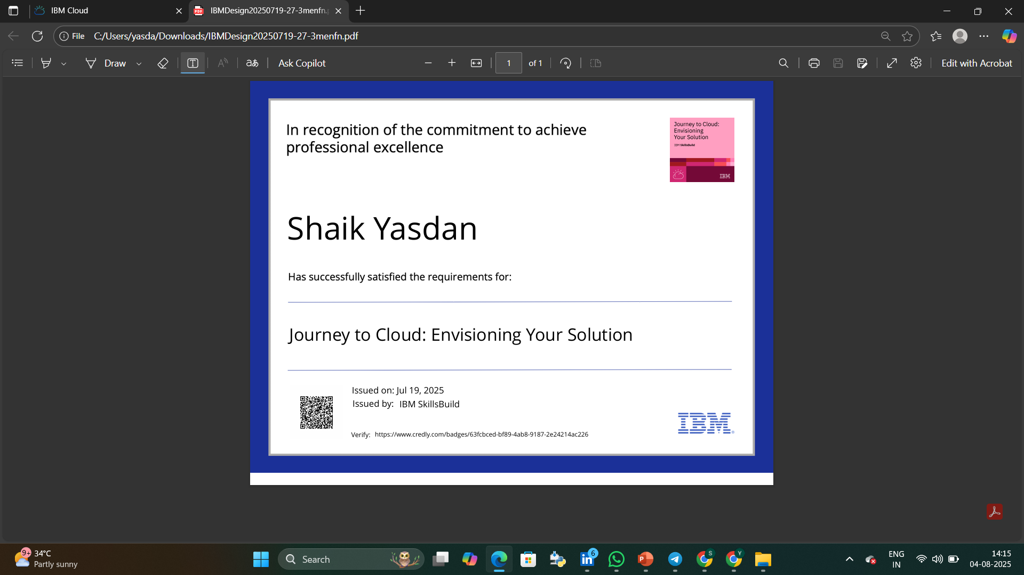
IBM Certifications
Screenshot/ credly certificate( Journey to Cloud)

Slide 17
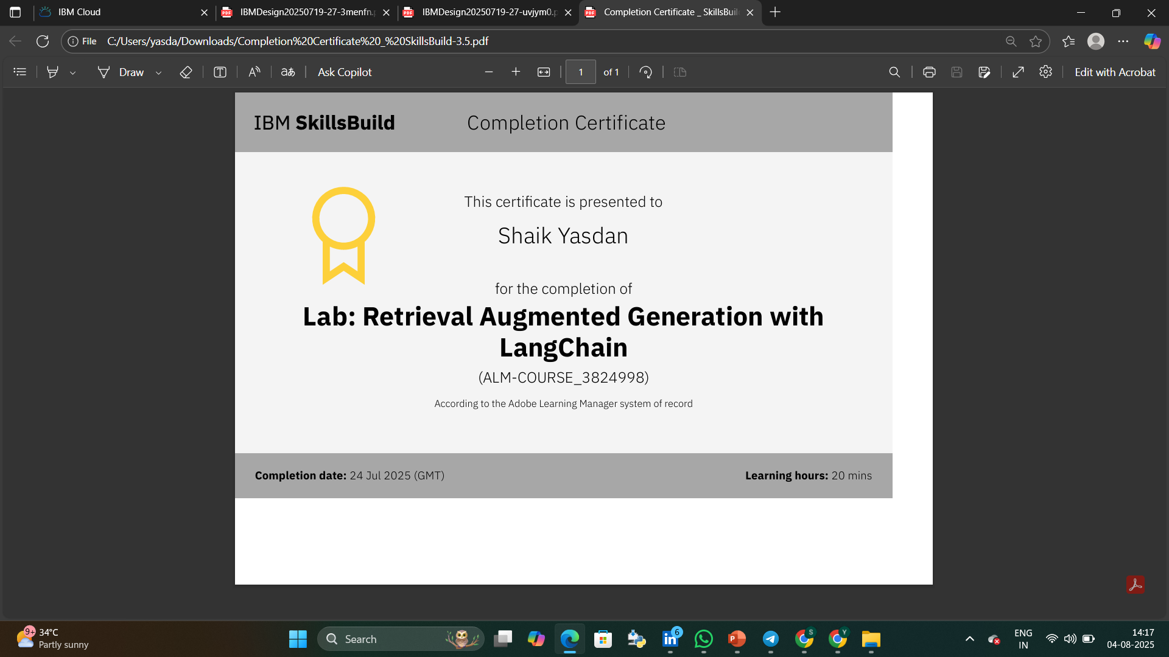
IBM Certifications
Screenshot/ credly certificate( RAG Lab)

Slide 18
THANK YOU

